Slide 1
Relational Reasoning
Relationship of object and human
20191003 Hyoungsung Kim
hyoungsung@gist.ac.kr
Notes:
Test

Slide 2
Compositional Learning for Human Object Interaction
Publish : ECCV 2018

Slide 3
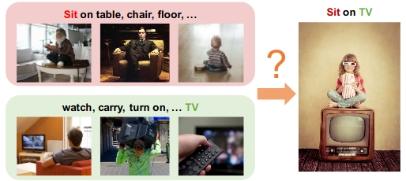
Contribution of this paper
Previous approaches about modeling actions and human-object interaction(HOI) require a lot of data
It is weak to new categories(zero shot learning)
Authors mentioned, zero shot learning is “Categories at testing time are not presented during training”
To handle unseen categories, authors propose a model with method using external knowledge graph and graph convolutional network

Slide 4
Why compositional learning
Human actions are naturally compositional and humans have amazing ability to achieve similar goals with different objects and tools.
For example , while one can use hammer for the hitting the nail, we can also use a hard-cover book for the same.
We can thus leverage this unique composition to help recognizing novel actions.

Slide 5
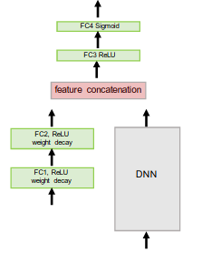
Intuitive understand of this paper
This part is replaced to Graph
Basic architecture for ZSL

Slide 6
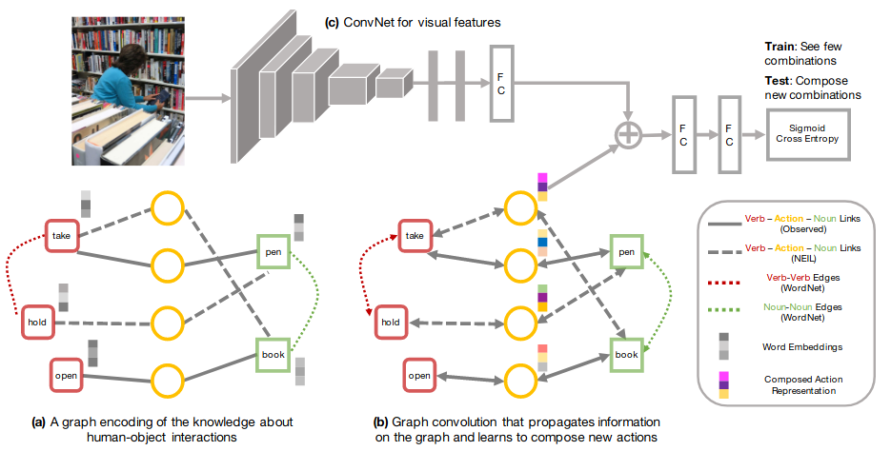
How…?
How can a model learn to compose a novel action within the context?
Authors propose to explore using external knowledge to bridge the gap of contextuality, and to help the modeling of compositionality for human object interactions.
Specifically, authors extract Subject, Verb and Object (SVO) triplets from knowledge bases to build an external knowledge graph.
These triplets capture a large range of human object interactions, and encode our knowledge about actions.
Notes:
gap of contextuality : 하드 커버 책을 망치 대신 사용하게 하는 방법을 어떻게 알게 할 것인가?

Slide 7
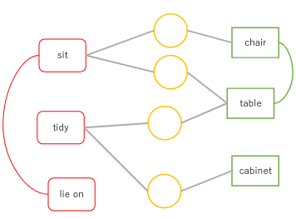
Graph representation of interactions
Pairs of verb-noun nodes are linked via action nodes (circle), and verb-verb/noun-noun pairs can be connected.
These action nodes start with all zero features, and must learn its representation by propagating information along the graph during training.
This information passing is achieved by using a multi-layer graph convolutional network

Slide 8
Model architecture - overview

Slide 9
Model architecture - Encoding knowledge
In this part, it encodes SVO(subject, Verb, Object) pairs to graph
Each verb or noun is represented as a node and comes with its word embeddings as the node’s features (word embedding : A kind of way to map natural language to vector space)
Verb and noun are connected by observation or external knowledge (WordNet : data from dictionary database, NEIL : data from web)

Slide 10
Model architecture - Graph convolutional network
Learning will propagate features on the graph, and fill in new representations for the action nodes. These action features are further merged with visual features from a convoluational network (Remember at first time actions start with all zeros features)

Slide 11
Model architecture - Convolution, concatenate, and ge score
CNN extract visual features from image
Extracted features are concatenated with action representation of graph

Slide 12
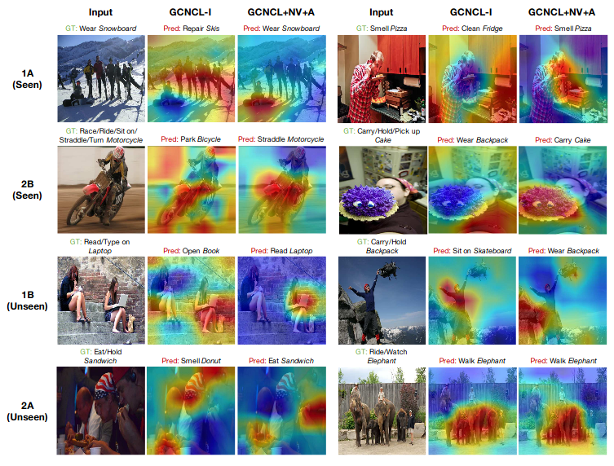
Result(Attention map using top-1 predict labels)
Red regions correspond to high prediction scores
GCNCL-I : Only include link of (verb, noun), (object, noun). e.g, There is no (verb, verb) or (object, object)
GCNCL : Add action edge using WordNet
A : Add action links from external knowledge
NV : Include new tokens(1 hop on WordNet)
1A, 2B, 1B, 2A : Name of subset
1 / 2 : Noun group
A / B : verbs group
For example, if 1A and 2B are used in training set, then 1B and 2A are not used in training
However testing set consists of {1A, 1B, 2A, 2B}
Notes:
(Authors mentions that this show best result.)

Slide 13
Recap
It increase neighborhood nodes of graph using external knowledge (Compositional learning)
Therefore, it is possible to get more features in GCNN
These features are helpful to recognize unseen categories

Slide 14
Learning to Detect Human-Object Interactions With Knowledge
Publish : CVPR 2019

Slide 15
Contribution of this paper
Authors focus on detecting human-object interactions(HOIs) in images, an essential step towards deeper scene understanding.
However, HOI categories exhibit a long-tail distribution
i.e., there exists some rare categories with very few training samples
For example, the number of “person riding a bike” > the number of “person riding elephant” in training sets
Authors tackle the challenge of long-tail HOI categories by modeling the underlying regularities among verbs and objects in HOIs as well as general relationships.
Authors propose multimodal joint embedding learning

Slide 16
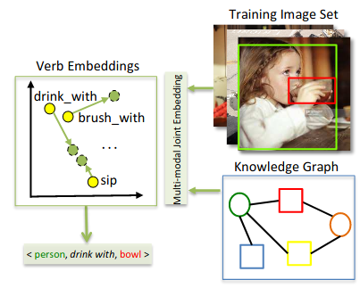
Conceptual illustration of multi-modal joint embedding learning
The proposed model learns a semantic structure aware embedding space compared to original word embeddings, such that it can leverage semantic similarity to retrieve the verb(s) best describing the detected <human,object> pair.
In the original word embedding space(Yellow color), “drink with” is mapped to be close to “brush with” possibly because of the shared “with” from word vector embeddings.
With the joint update from knowledge graph and training imageset, the model is more likely to comprehend the meaning of “drink” as its neighbors include “sip”(Green color).

Slide 17
Compare with first paper and second paper
Commonalities
Both are leverages semantic regularities from linguistic knowledge(and external knowledge)
Differences
First paper of this slide do not explicitly consider the joint impact from the referent source and visual information.
In contrast, second paper(Current paper) emphasizes on the joint update of the verb embeddings from vision and linguistic knowledge by introducing a multi-modal embedding module to dynamically learn the semantic dependencies of the concepts
In the context of HOI detection that verbs and interacting objects are linked with semantic structures.

Slide 18
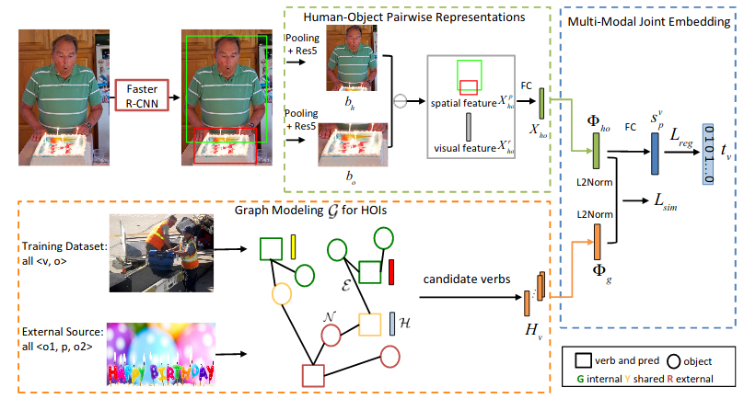
Illustration of the proposed verb embedding learning
Notes:
(Why substrat? for visual translation embedding -> reference에서 가져왔음
S_p^v : score of spatial configuration. (spatial configuration : location)
X : representation
X_{ho} : pairwise representaion

Slide 19
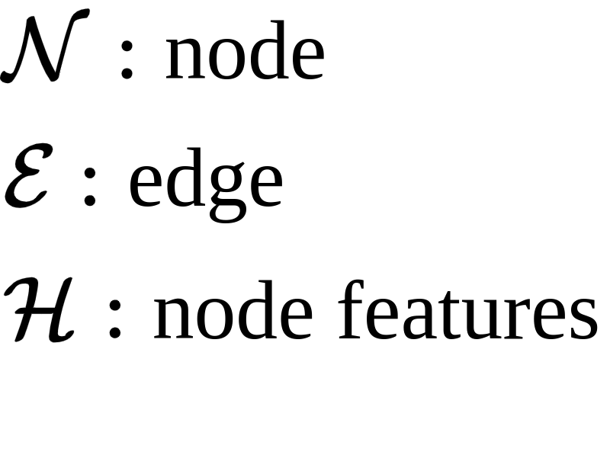
Detail - Graph modeling
In order to boost learning of long-tail classes, authors exploit a graph-based approach to model the semantic dependencies from linguistic knowledge complementing the training visual representations
Specifically, the graph structure is used to capture the semantic dependencies amongst verb and object categories in HOIs, and general visual relationships.
Edges connect valid pairs. As a result, the tail verb classes are impacted from its neighbors on the same object node. (e.g. “person ride bike“ and “person ride elephant“ share object.)
Exactly, training dataset and visual relationship dataset are connected.
Notes:
pred : predicate(술부)
첫번째 논문과의 차이점 : edge연결 하는 방식이 다름. 첫번째에서는 외부 정보를 이용하여 주어진 데이터사이를 연결
여기서는 외부 정보와 주어진 데이터를 연결

Slide 20



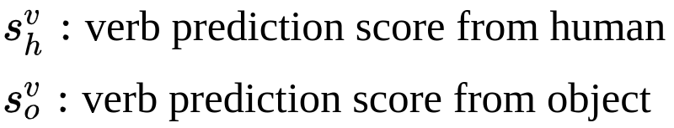
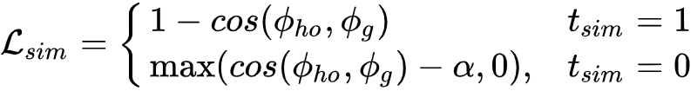

Detail - Multi-modal Joint Embedding
The objective of the joint embedding learning is to maximize the similarity between positive L2Norm and minimize it between all non-matching pairs to a specified margin
Intuitively, we want to get a similar result(similar verb) from CNN and GNN
Notes:
\pi의 결과는 벡터 -> 벡터끼리 cosine similarity 계산 함
v는 그래프 입력의 verb

Slide 21
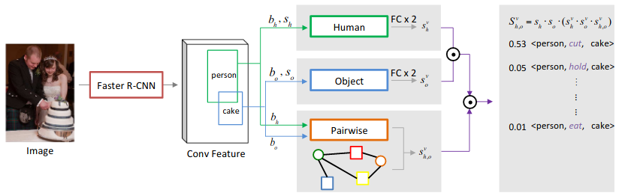
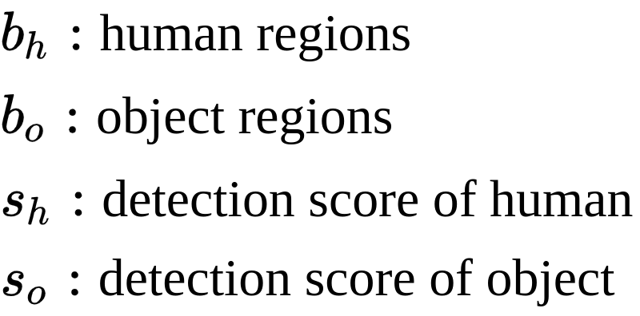
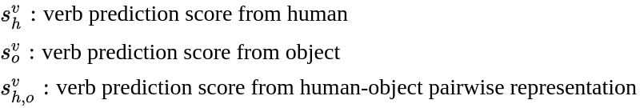

Inference procedure
Element-wise multiplication
Notes:
분량 너무 많으면 이 슬라이드 삭제

Slide 22
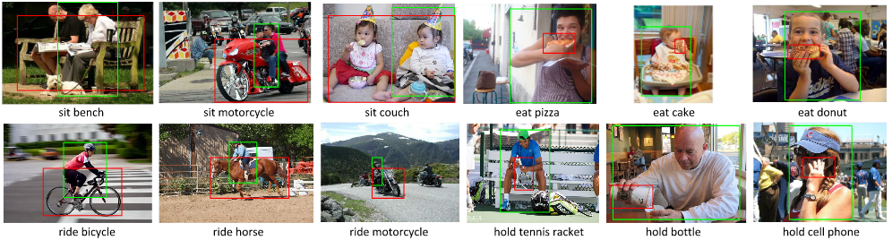
Result
Evaluate correctly detect all of the <human,verb,object> triplets for animage(True positive).
The predicted triplet label is the same as the ground-truth
both the predicted human and object bounding boxes have intersection-over-union (IoU) greater than 0.5 w.r.t the ground-truth annotations

Slide 23
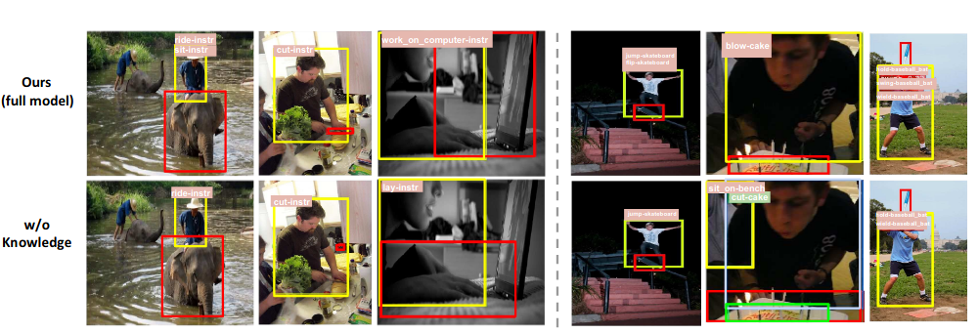
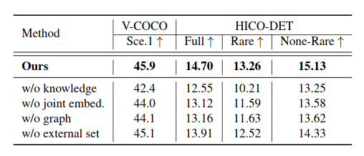
Ablation study
Mean average precision
w/o knowledge : use CNN only
w/o joint embedding : Concatenate results of cnn and knowledge. And pass it to Fully Connected layer
w/o graph : feed word2vec instead of result of knowledge graph
w/o external set : without external knowledge
(Full) all 600 HOI categories in HICO, (Rare) 138 HOI categories with less than 10 training instances, (Non-Rare) 462 HOI categories with 10 or more training instances.

Slide 24
Recap
In first paper, external knowledges are used to extend a connection of training data (i.e., External knowledge is used to make edges)
In this paper, external knowledges are connected to training dataset (i.e., External knowledge is used to make new nodes)
Multi-modal embedding module uses vision and linguistic information

Slide 25
Interact as You Intend: Intention-Driven Human-Object Interaction Detection
Publish : IEEE Trans on Multimedia 2019
(Same authors with second paper)

Slide 26
Contribution of this paper
Authors provide a unique computational perspective to explore human intention in HOI detection.
Specifically, the proposed human intention-driven HOI detection (iHOI) framework models human pose with the relative distances from body joints to the object instances.
In this work, Authors provide a novel computational perspective to exploit two forms of human intention that is visually observable:
Human gaze, which explicitly conveys intention
Human body posture, which implicitly conveys the intention.
In contrast to previous works treating humans and objects similarly, with no consideration that human behaviors are purposeful, authors argue that human intention drives interactions.
Therefore, in this work, authors exploit the cues in an image that reflect an actor’s intention, and leverage such information for more effective HOI detection

Slide 27
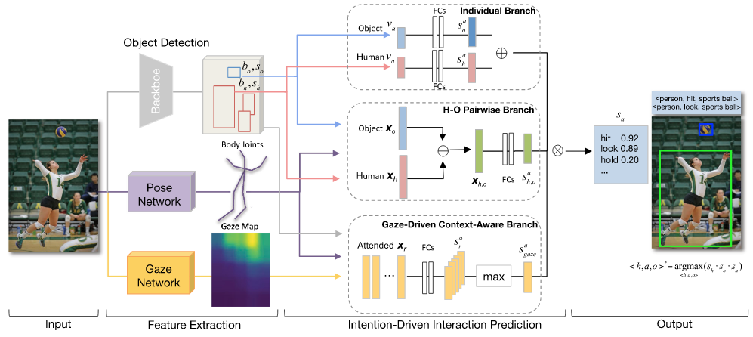
Proposed model architecture
The proposed iHOI takes an image as input for feature extraction and human intention-driven interaction prediction, and outputs the detected triplets(<human, hit, sports ball>).
Goal is finding best action score.

Slide 28
Feature Extraction
It uses faster R-CNN(same with second paper)
Human body joints locations and gaze direction are obtained through transfer learning from other social-activity datasets, since authors aim is to effectively model intention rather than extract features, and both experimental datasets lack the ground-truth.
Output of gaze network : probability density map

Slide 29
H-O Pairwise Branch
Basically, it is same with second paper’s one.
However, it extends the feature space with human pose information.
Human pose bridges the human body with the interacting object.
Feature representation X includes encoded pose information(distance from joints)

Slide 30
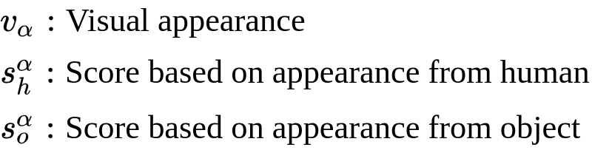
Individual Branch
Calculate scores from human and object
Scores are fused by element-wise summation

Slide 31
Gaze-Driven Context-Aware Branch
We observe that the regions where an actor is fixating often contain useful information for the interactions.
Therefore, we exploit the fixated contextual information to help recognizing the actor’s action
In particular, we use human gaze as a guidance to leverage the fixated scene regionsc
Notes:
(x,y) of G : location point of b

Slide 32
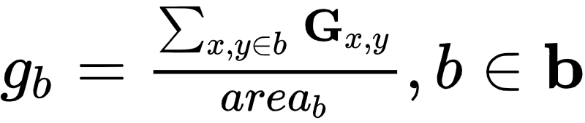

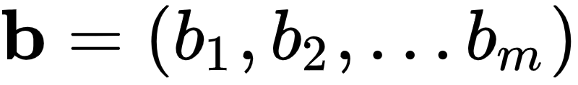
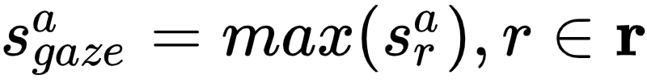
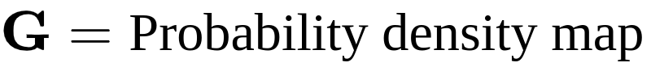
Gaze-Driven Context-Aware Branch(Continue)
Score(S) : Results of FC layers
b is region from object detector
Notes:
(x,y) of G : location point of b
score : result of prediction

Slide 33
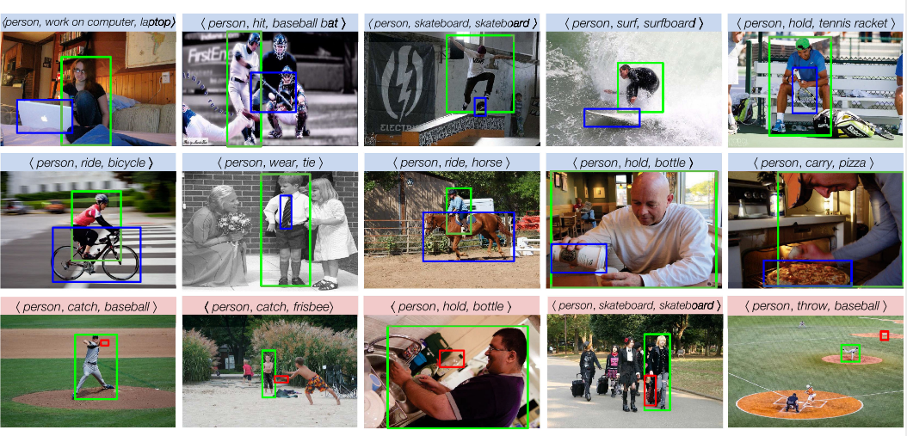
Result
Top 2 rows : correct prediction
Last low : false positive

Slide 34
Q & A

